Slide 1
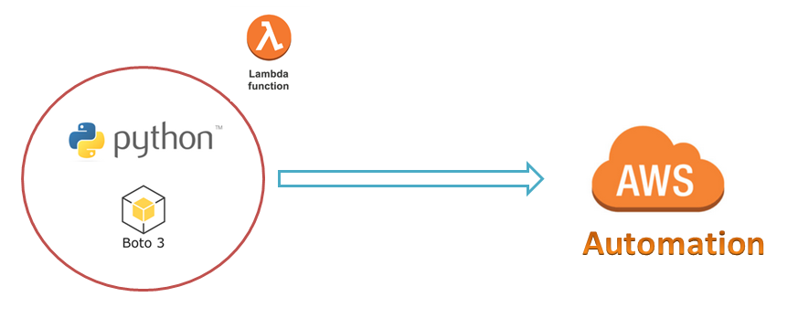
AWS Automation
with
boto3 of Python and Lambda Functions
Loop control statements or commands
(break and continue)
Learn how to automate AWS common tasks using boto3 and Lambda

Slide 2

Objective of this course:
The objective of this course is to cover the core concepts of boto3 and Lambda.
This course is designed to understand boto3 and Lambda concepts with real-time scenarios.
This course is divided into two parts.
Part-1: Writing and Executing Python boto3 on our local server(Any OS)
Part-2: Writing and Executing Python-boto3 in lambda with different triggering methods.
By the end of this course:
You will get the knowledge to apply different concepts of boto3 and Lambda for different AWS Services.
Loop control statements or commands
(break and continue)
Learn how to automate AWS common tasks using boto3 and Lambda

Slide 3
Thank you

